Slide 1
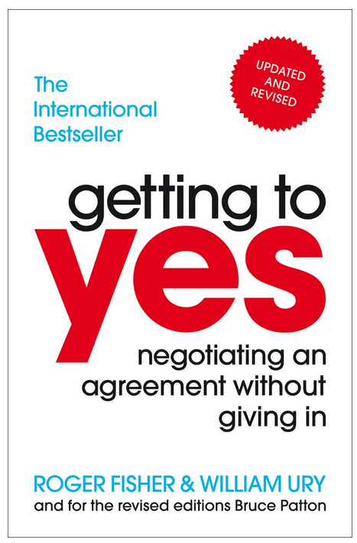
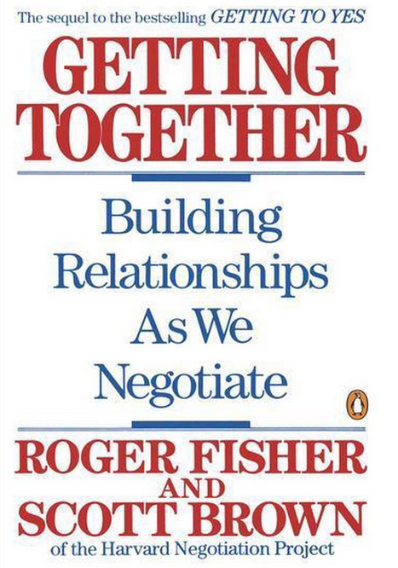
The art of principled negotiation
Moderated by:
Gerben ter Riet & Gowri Gopalakrishna

Slide 2
Schedule for negotiation part
21.00-21.10h Theory
21.10-21.30h Practice in subgroups
21.30-21.45h Plenary discussion

Slide 3

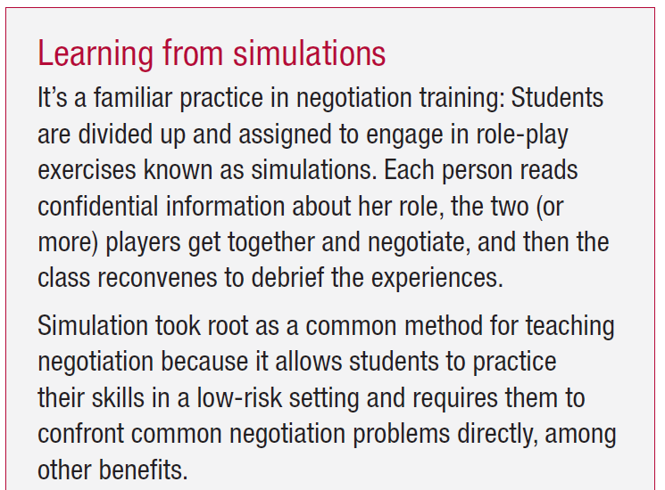
Harvard Negotiation Project
https://www.pon.harvard.edu/about/welcome/

Slide 4

Five main principles
Don’t bargain over positions
Arguing over positions endangers relationships
Separate the people (soft) from the problem (hard)
Put yourself in their shoes
Invent options for mutual gain
Separate inventing from deciding
Insist on using objective criteria
Never yield to pressure
Know your BATNA
Criteria for walking away

Slide 5
Comparing soft, hard and principled ways of negotiation
Topic | Soft | Hard | Principled
Participants | Friends | Adversaries | Problem solvers
Objective (aim) | Agreement | Victory | Efficient and balanced outcome
Relationship | Concede to keep the relationship good | Demand concessions to keep the relationship good | Separate problem from people
Problem and relationship | Soft on both | Hard on both | Soft on person, hard on the matter
Trust | Trust the other | Distrust the other | Progress independent of trust
Position | Easy to change | Dig in | Focus on shared interests, not on positions
Style | Do proposals | Express threats | Explore their interests behind the positions
Final outcome | Express your desired outcome | Mislead about your desired outcome | Avoid fixing a final outcome early
Reflection | Accept one-sided loss | Demand one-sided gains | Find solutions with mutual gain
Answer | Look for a single answer that satisfies the other | Look for a single answer that satisfies me | Develop multiple options from which to choose later
Insisting on | Agreement | My position | Insist on objective criteria
Willpower | Avoid conflict | Win conflict | Principles should prevail
Pressure | Yield | Exert | Yield only to arguments, not to pressure

Slide 6
Importance of preparing a BATNA
BATNA= Best Alternative To a Negotiated Agreement
What are my realistic options if I walk away without an agreement?
Avoid a psychological trap: adding various options in your head whereas in reality you can only choose one
Step 1 in any negotiation; develop a BATNA. It is your benchmark. If BATNA > negotiate, do not negotiate, but walk away
Notes:
https://www.pon.harvard.edu/category/daily/

Slide 8
3rd year PhD student (confidential information)
Your promotor added 2 co-authors to one of your manuscripts that you had sent him for the truly final 5th round feedback the paper (98% finished). One is a famous professor who, in your mind, does not fulfil the requirements for authorship by any standard. The other is a fellow PhD student of yours who is in the final stages of her PhD trajectory with whom you have an excellent relationship.
Your promotor has been appointed as professor 2y ago, is a nice although sometimes slightly authoritarian (wo)man keen to be successful internationally.
Your current manuscript is the 4th out of 6 planned papers in your PhD thesis.
On the current paper, there are 3 authors in total (excluding the 2 (honorary) authors now proposed)
Your interests: not engage in QRPs, stick to official (International Committee of Medical Journal Editors (ICMJE), Committee On Publication Ethics (COPE), ..) rules, prevent dilution of other authors’ contribution, prevent precedents, prevent moral decline at the department in general, keep good relationships with your promotor and with your fellow PhD student.
Notes:
https://embassy.science/wiki/Instruction:522ba3d0-9f26-41d5-9ecf-b4c88214887c
https://www.icmje.org/recommendations/browse/roles-and-responsibilities/defining-the-role-of-authors-and-contributors.html
https://publicationethics.org/files/2003pdf12_0.pdf
https://www.elsevier.com/authors/policies-and-guidelines/credit-author-statement

Slide 9
The PhD student’s promotor (confidential information)
You requests that another PhD student of yours, who struggles with her last chapter due to private problems, be co-author on the paper.
In addition, you request that a colleague professor at a renowned institute with whom you want to build a closer relationship be co-author on the paper.
Interests: help the other PhD student complete her thesis + also ensuring that Govt. cash (90k) comes in; Increase chances of publishing in a more esteemed journal using the prestige of the other professor. Take the next step in building an excellent relationship with other professor; keep good relationship both PhD students; strengthen your position as a strong leader; long-term success for her/himself and the Dept.

Slide 10


Slide 11
Yes, but
What if they are more powerful?
Best Alternative To a Negotiated Agreement (BATNA)
What if they won’t play?
Don’t defend your ideas, invite criticism and advice
What if they use dirty tricks?
Where to meet?
Personal attacks
Escalating demands
Negotiating about the rules of the game

Slide 12
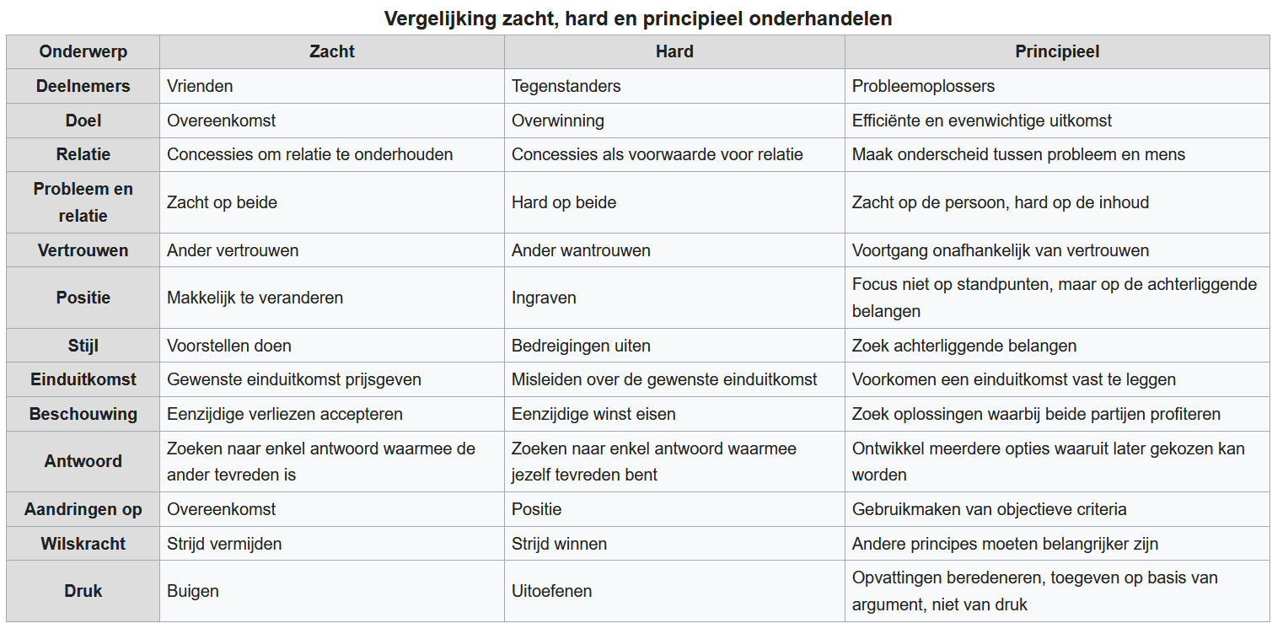
Notes:
https://nl.wikipedia.org/wiki/Excellent_onderhandelen

